Slide 1
Using Dilution Panel to Monitor Kit Quality
International Laboratory Branch- Serology & Incidence Team
RTCQI Best Practice Workshop-Western Hemisphere Region

Slide 2
Purpose
To verify the performance of test kit at national level before distribution
  New kit lot
  New shipment
  When temperature exceeds manufacturer’s recommendations
To conduct post-market surveillance of kit after distribution
  Appropriate storage at site level

Slide 3
Before Panel Preparation
Identify and select 2 HIV positive plasma units.
  Positive or reactive by all HIV testing methods used in country
  Bulk volume
Identify and select at least one HIV negative plasma units (or base matrix)
  Negative by all tests or base matrix (can be purchased commercially), if available.
Make sure that samples are clear of any clots or fibroids.
Include at least one HIV-2 specimen if the kits claim both HIV-1 and HIV-2 diagnosis
Develop an SOP to prepare dilution panels
  Generic SOP available on RTCQI website

Slide 4
Preparation of dilution panel
Calculate the amount of negative plasma required for preparing 1 dilution set 10 times with 5-fold dilution factor. Follow the same procedure for set #2.
Aliquot specimens (400ul), label and store
Total number of specimens = 20

Slide 5
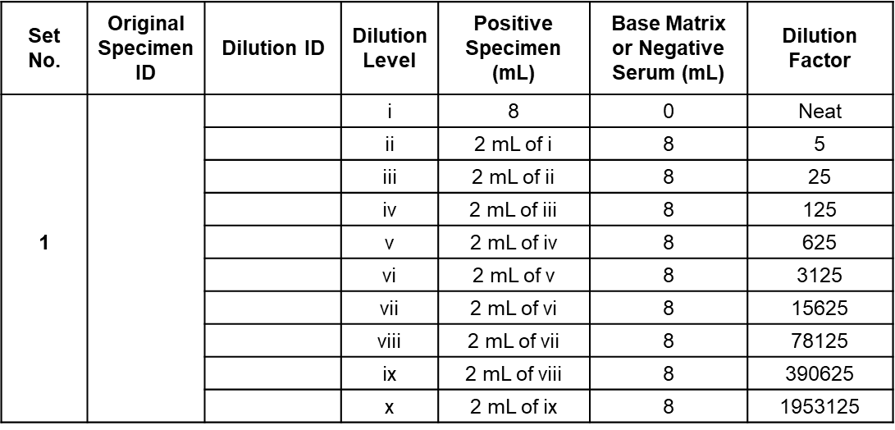
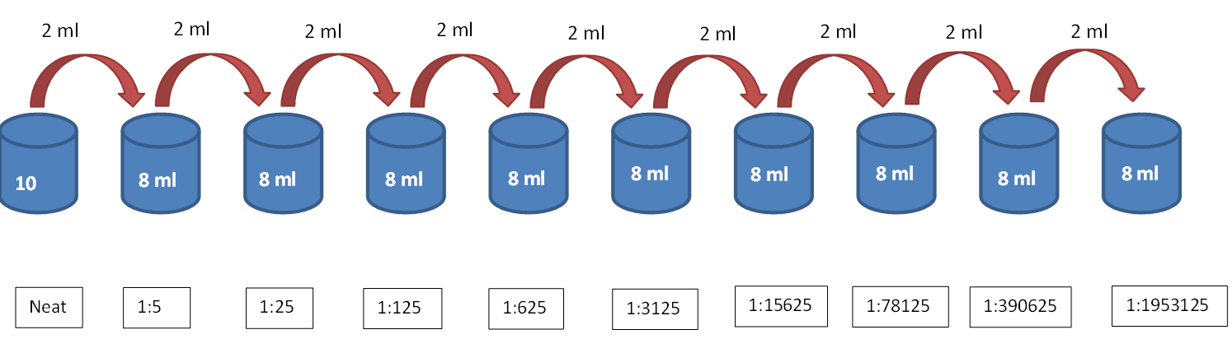
Dilution schematic

Slide 6
Reference Results
Once panel is prepared have it tested to create your reference results
  Three different operators should perform testing on all HIV rapid tests used in the testing algorithm with this panel
  Use the 2 out of 3 results in agreement for final result for a particular specimen

Slide 7
Pass Fail Criteria
Kit Lot should be approved if:
  Expected overall agreement between reference data and new kit lot is 90% or higher (minimum 90/100) = PASS
  & there is only a variation of +/- 1 dilution per panel
If test results are not acceptable, then troubleshooting and additional testing are necessary
If problem persists, the lot must be rejected and cannot be used for testing

Slide 8
Comparative Results on Dilution Panels
 |  |  | New lot | New lot
Dilution | Spec ID | Lot A | Lot B | Lot C
0 | RTV-DT 1 | P | P | P
5 | RTV-DT 2 | P | P | P
25 | RTV-DT 3 | P | P | P
125 | RTV-DT 4 | P | P | P
625 | RTV-DT 5 | P | P | P
3125 | RTV-DT 6 | P | P | P
15625 | RTV-DT 7 | P | P | P
78125 | RTV-DT 8 | P | P | P
390625 | RTV-DT 9 | P | P | P
1953125 | RTV-DT 10 | N | N | N
Agreement |  | Ref Lot | 100% | 100%
 |  |  | New lot | New lot
Dilution | Spec ID | Lot A | Lot D | Lot E
0 | RTV-DT 1 | P | P | P
5 | RTV-DT 2 | P | P | P
25 | RTV-DT 3 | P | P | P
125 | RTV-DT 4 | P | P | P
625 | RTV-DT 5 | P | P | P
3125 | RTV-DT 6 | P | P | P
15625 | RTV-DT 7 | P | P | P
78125 | RTV-DT 8 | P | P | N
390625 | RTV-DT 9 | P | N | N
1953125 | RTV-DT 10 | N | N | N
Agreement |  | Ref Lot | 90% | 80%
Dilution panel 2 Dilution panel 1
 |  |  | New lot | New lot
Dilution | Spec ID | Lot A | Lot B | Lot C
0 | RTV-DT 11 | P | P | P
5 | RTV-DT 12 | P | P | P
25 | RTV-DT 13 | P | P | P
125 | RTV-DT 14 | P | P | P
625 | RTV-DT 15 | P | P | P
3125 | RTV-DT 16 | P | P | P
15625 | RTV-DT 17 | P | P | N
78125 | RTV-DT 18 | N | N | N
390625 | RTV-DT 19 | N | N | N
1953125 | RTV-DT 20 | N | N | N
Agreement |  | Ref Lot | 100% | 90%
 |  |  | New lot | New lot
Dilution | Spec ID | Lot A | Lot D | Lot E
0 | RTV-DT 11 | P | P | P
5 | RTV-DT 12 | P | P | P
25 | RTV-DT 13 | P | P | P
125 | RTV-DT 14 | P | P | P
625 | RTV-DT 15 | P | P | N
3125 | RTV-DT 16 | P | N | N
15625 | RTV-DT 17 | P | N | N
78125 | RTV-DT 18 | N | N | N
390625 | RTV-DT 19 | N | N | N
1953125 | RTV-DT 20 | N | N | N
Agreement |  | Ref Lot | 80% | 70%
Overall agreement 100% 95%
Overall agreement 85% 75%

Slide 9
Conclusion
The lot-to-lot reference panel should be stored at -20°C or below for long-term storage, but once a set has been thawed, it should be kept at 4°C for up to 7 days
Kit quality monitoring is necessary to prevent use of suboptimal kit lots
Kit quality monitoring is one of the RTCQI Pillars, and most laboratory regulations and accreditation standards require the evaluation of each new kit lot prior to use

Slide 10
Thank you!
Please contact the CDC ILB team for any follow up questions!

